Slide 1
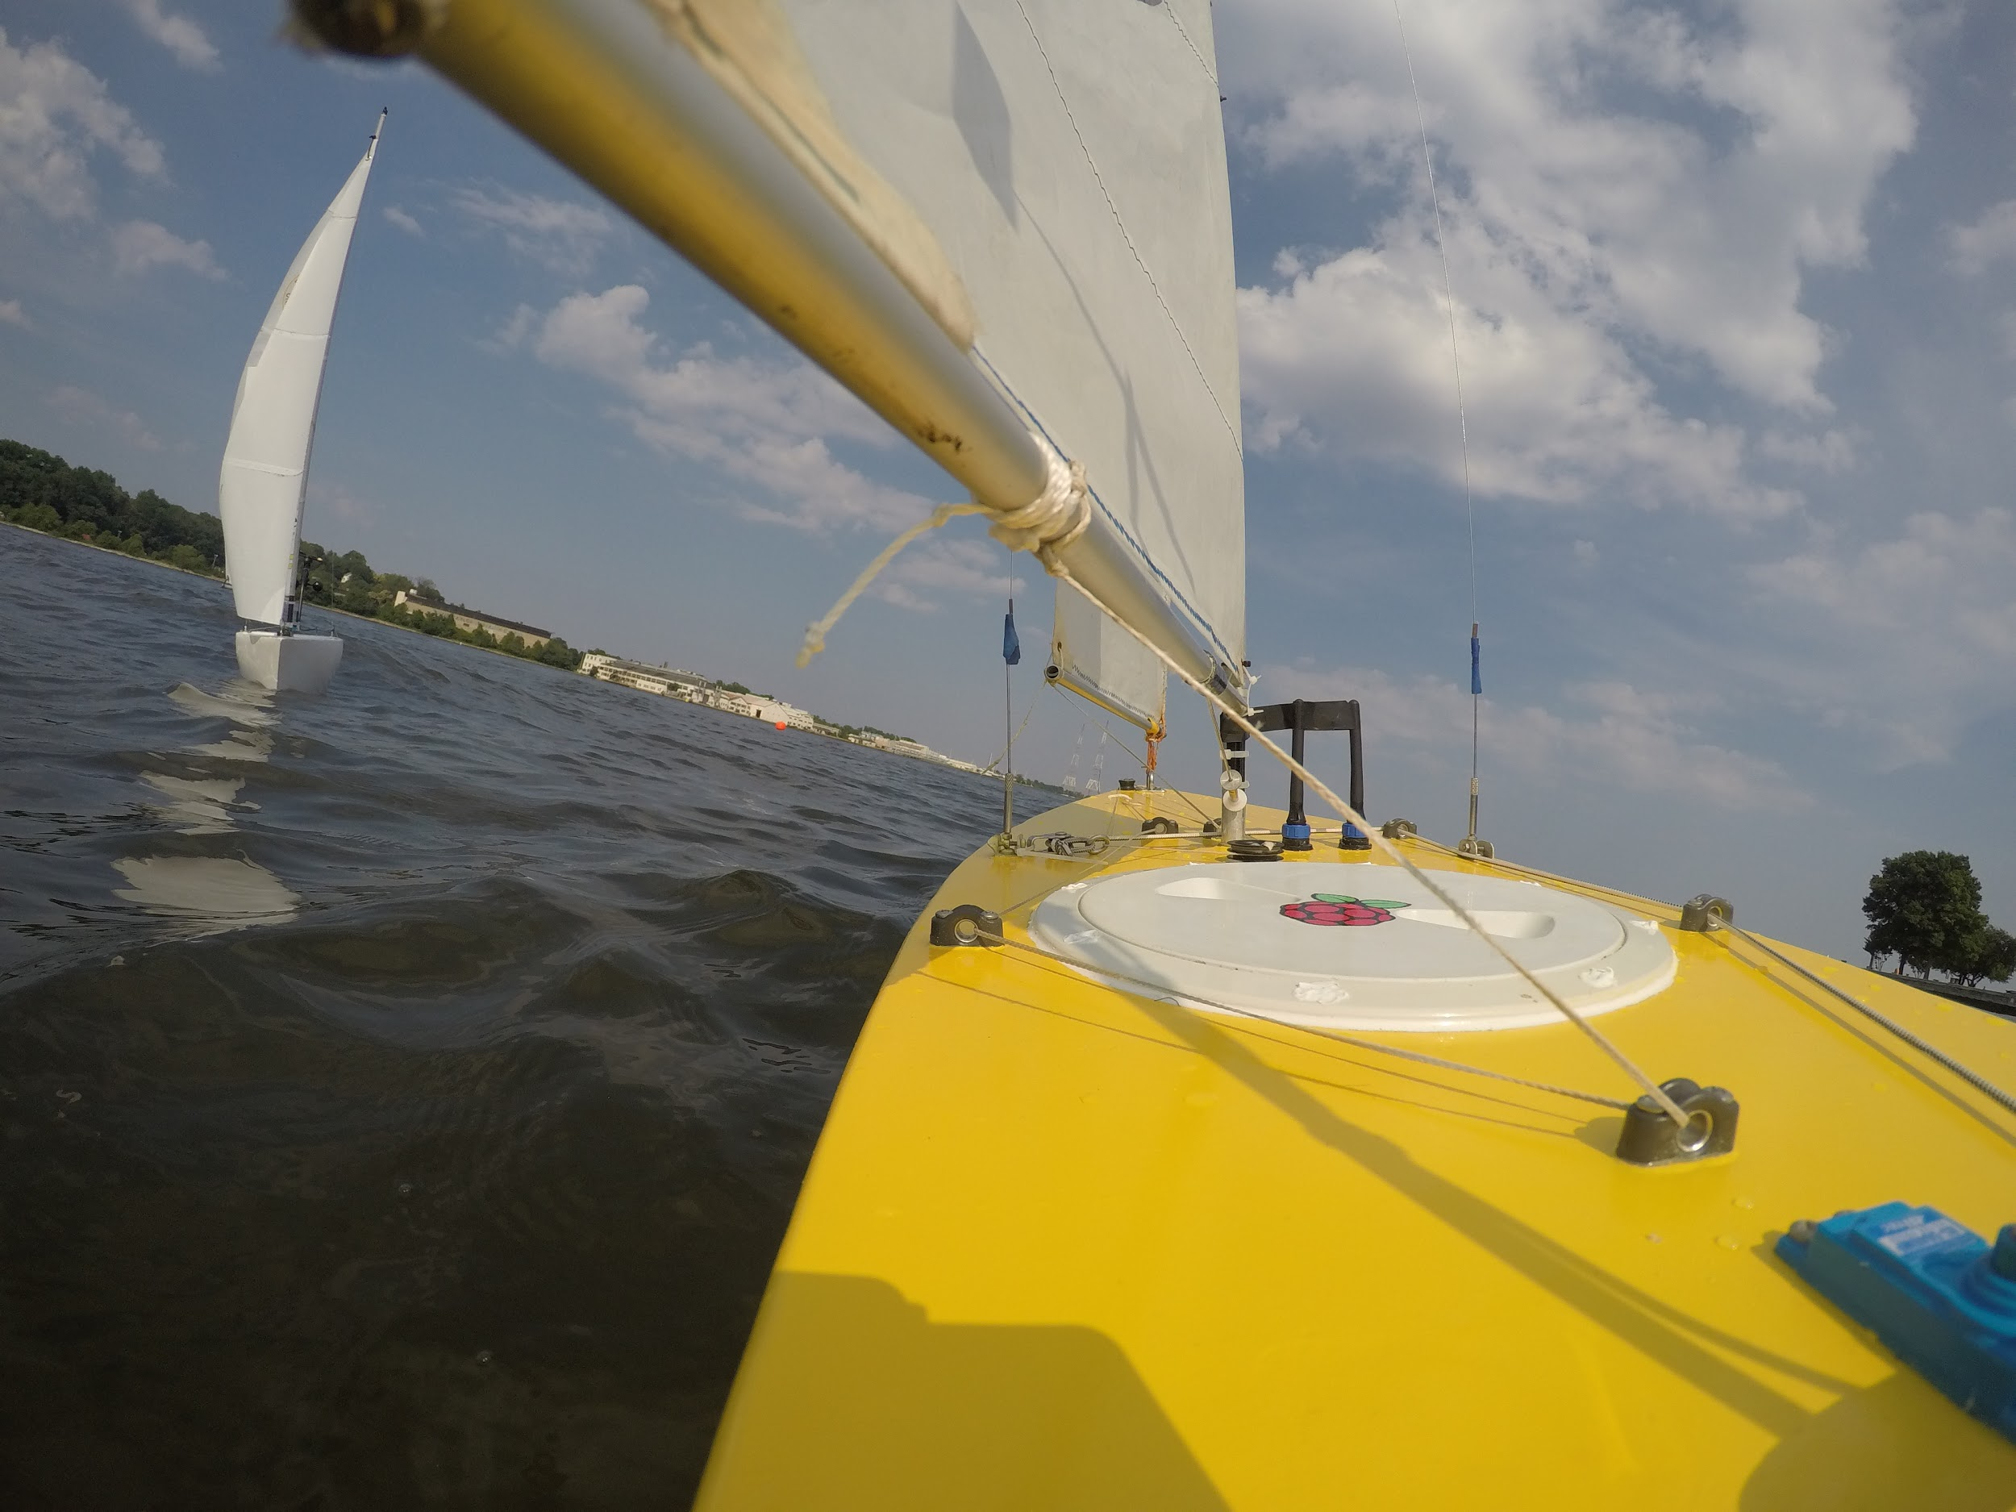

Want to join AberSailbot
the student robotic sailing team?
Open to all students
All years, all departments, undergraduates and postgraduates.
No prior knowledge assumed!
Come to:
Room MP-3.02 Monday October 1st @ 14:00
abersailbot.co.uk/joinus
Notes:
Introduce the team etc

